Slide 1

Predictive Modeling for Loan Default Risk Management
By: Jun ming li, Jairo onate, and mazen alhaffar

Slide 2
Table of contents
01
04
02
05
03
06
Model Evaluation
Introduction & Variables Dictionary
Key Insights
Data Cleaning & Preprocessing
Data Modeling
Conclusion & Q&A

Slide 3
Introduction
Objective | The objective is to predict the loan default of customers in the banking industry
Risk Mitigation | Identifies high-risk borrowers to reduce financial losses
Improved Credit Assessment | Enhances loan approval decisions with data-driven insights
Cost Efficiency | Reduces operational costs by streamlining the credit evaluation process
Customer Relationships | Enables personalized solutions to support borrowers
Competitive Advantage | Provides a smarter approach to risk management

Slide 4
Variables Dictionary
NAME_CONTRACT_TYPE | Identification of loan is cash or revolving
FLAG_OWN_CAR | Flag if the client owns a car
FLAG_OWN_REALTY | Flag if client owns a house or flat
AMT_INCOME_TOTAL | Income of the client
NAME_EDUCATION_TYPE | Level of highest education the client achieved
NAME_HOUSING_TYPE | Housing situation of the client (renting, living with parents, ...)
REGION_POPULATION_RELATIVE | Normalized population of region where client lives (higher number = more populated region)
DAYS_BIRTH | Client's age in days at the time of application
DAYS_EMPLOYED | Days before the application the person started current employment
OCCUPATION_TYPE | Client's occupation type
FLAG_DOCUMENT_2 | Indicates if document 2 was provided
NAME_CONTRACT_TYPE_prev | Contract product type (Cash loan, consumer loan [POS], ...) of the previous application
NAME_CONTRACT_STATUS | Contract status (approved, cancelled, ...) of the previous application
DAYS_DECISION | Relative to current application when the decision about previous application was made
LoanGoodR_df1 | Loan to Goods Price Ratio for current applications
TARGET | Target variable (1 = payment difficulties, 0 = no difficulties)

Slide 5



Summary Statistics

Slide 6
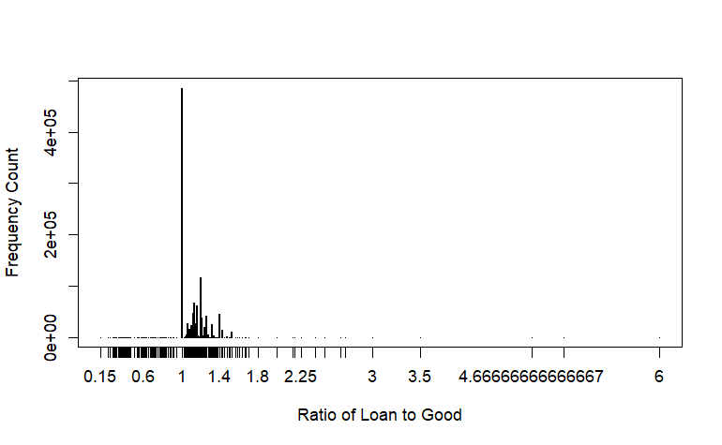
Summary Statistics
Dataset Overview: 1,413,701 rows and 16 variables, capturing customer demographics, financial details, and loan application data.
Target Variable: 91% of loans were repaid without issues (TARGET = 0), while 9% represent loan defaults (TARGET = 1).
Income and Credit: Mean annual income is $173,316, mean credit amount is $587,554, and mean goods price is $527,728.
Age: Mean client age is 44 years.
Housing and Ownership: 89.7% of clients own real estate, while 34% own a car. Majority of clients live in owned housing (90%), with smaller proportions renting or having no housing ownership.
Previous Loans Status: Most prior loans were approved (63%).
Geographic Trends: Clients predominantly reside in regions with moderate population densities (mean: 0.02).
The median value of 1.00 indicates that, on average, clients borrow an amount equivalent to the value of the goods they purchase

Slide 7

01
Data Cleaning & Preprocessing

Slide 8
Data Cleaning & Preprocessing
Numerical Data Processing:
8.39M missing fields across 307K records and 74 variables.
Negative values were converted to positive.
Missing values were replaced with the mean (excluding binary variables).
Previous Application Dataset:
Initially contained 1.67M records, 37 variables, and 16.64% missing fields.
Mean imputation reduced missing data by 86%, leaving 1.43M fields requiring further processing.
Categorical Data Processing:
Combined and reduced classes.
Used imputation to replace NAs, but preserve robustness of data set.

Slide 9

02
Data Modeling

Slide 10
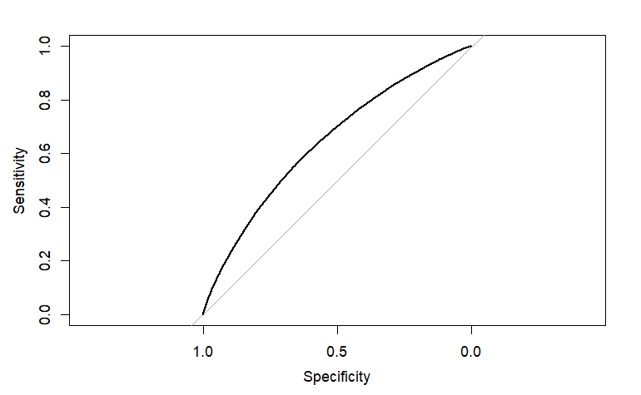
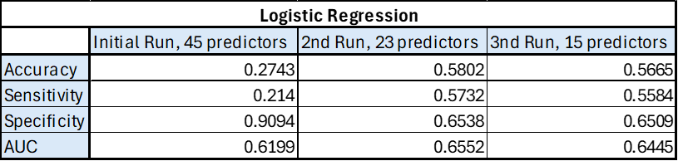
Logistic Regression
AUC Curve - 15 Predictors Run
Accuracy: 55.65%
AUC: .6445
AUC is at 0.6445, indicating the model performs better than a random classification

Slide 11
Random Forest
The AUC (Area Under the Curve) improves as the number of variables selected (mtry) increases from 4 to 16.
Accuracy also improves as the number of variables (mtry) increases from 4 to 16, following a similar trend to AUC.

Slide 12

03
Model Evaluation

Slide 13
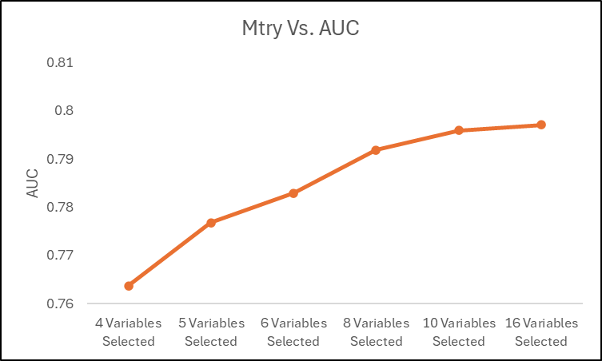
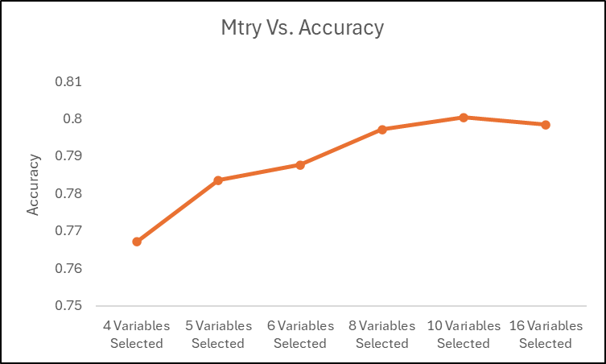
Random Forest Performance
Model performance improves consistently with more variables, but the improvement diminishes after 8 variables.
The highest accuracy and AUC are achieved at 10-16 variables, but 8 variables offer a good balance between performance and efficiency.

Slide 14
Model Performance Comparison
Model | AUC | Accuracy | Sensitivity | Specificity
Baseline | .6199 | .2743 | .214 | .9094
Logistic Regression (15 Predictors) | .6445 | .5665 | .5584 | .6509
Random Forest (mtry = 8 run) | .7919 | .7971 | .7982 | .7856
Compared to our baseline, our improved logistic and random forest models has significantly improved performance.

Slide 15

05
Key Insights

Slide 16
Key Insights
Variable Importance
Model Selection
Feature Contribution
"Days employed," "age," and "loan-to-goods ratio" were top predictors of loan default risk.
Most accurate is not always the “best” model.
Days employed odds = decreases by 97%
Age odds = Decreases by 76%
Loan-to-goods ratio odds = increases by 120%

Slide 17


Conclusions & Recommendations
Technical
Recommendations made adhering to the parsimony principle.
While the Logistic Regression with 23 predictors has the best performance, the 15-predictor model is recommended for banks when using a logistic approach.
Random Forest with 8 predictors chosen with 9.71% Accuracy, 79.82% Sensitivity, 78.56% Specificity and 79.19% AUC.
Business
Simplifying the model enhances transparency and computing efficiency, making it ideal for real-time applications.
The classification model balances interpretability and accuracy, making it valuable for commercial applications requiring clear decision-making.

Slide 18

Thank You!

